Slide 1
What is Flexbox?

Slide 2
The Flexbox is more efficient way to lay out, align and distribute space among items in a container, even when their size is unknown and/or dynamic (thus the word "flex").
Best for orientation changing, resizing, stretching, shrinking.

Slide 3
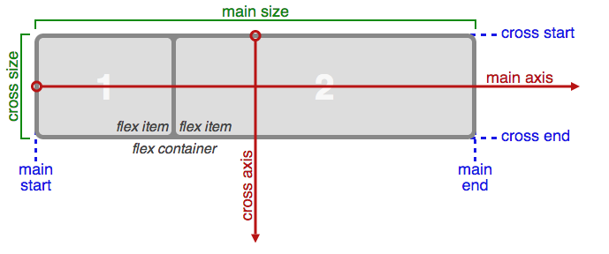
Flexbox Guide

Slide 4
Flexbox Properties

Slide 5
- flex
- flexDirection
- flexBasis
- flexGrown
- flexShrink
- flexWrap
- alignItems
- alignSelf
- justifyContent
- Order

Slide 6
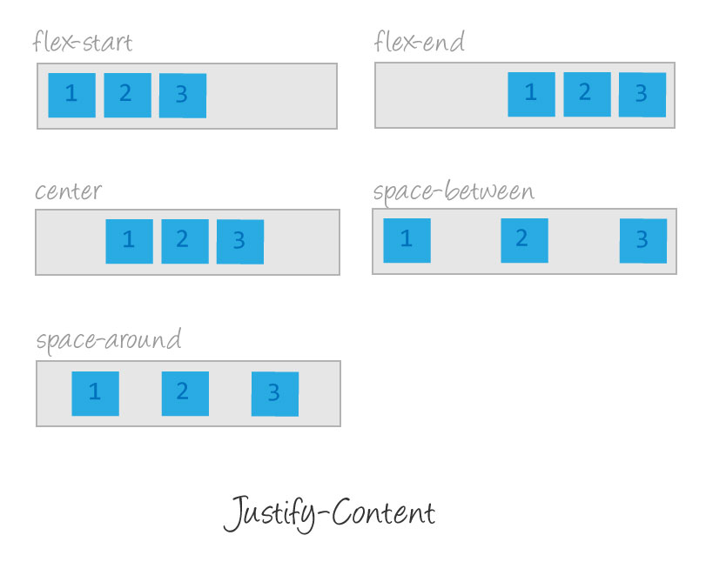
justify-content Property
justify-content: aligns items horizontally, (along the main axis) and accepts the following values:
flex-start: Items align to the left side of the container.
flex-end: Items align to the right side of the container.
center: Items align at the center of the container.
space-between: Items display with equal spacing between them.
space-around: Items display with equal spacing around them.

Slide 7
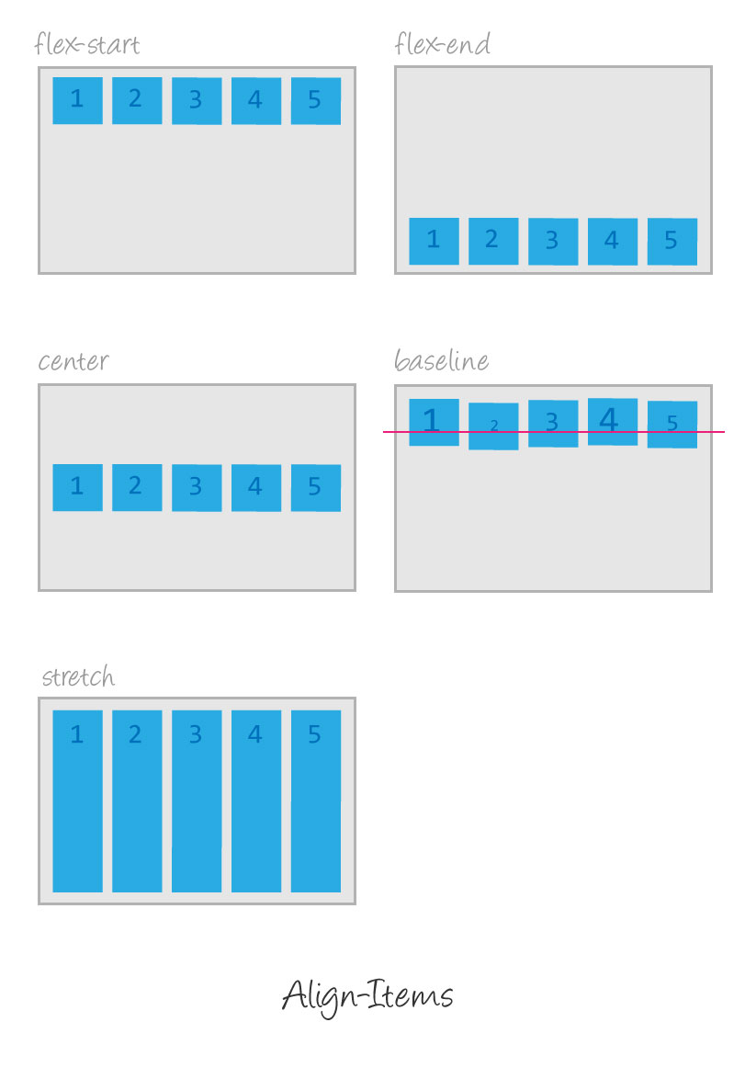
align-items/align-self Property (same)
align-items: aligns items vertically (along the cross axis) and accepts the following values:
flex-start: Items align to the top of the container.
flex-end: Items align to the bottom of the container.
center: Items align at the vertical center of the container.
baseline: Items display at the baseline of the container.
stretch: Items are stretched to fit the container.

Slide 8
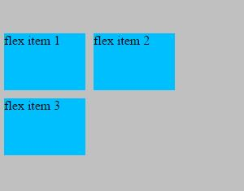
align-content Property
align-content to set how multiple lines are spaced apart from each other. This property takes the following values:
flex-start: Lines are packed at the top of the container.
flex-end: Lines are packed at the bottom of the container.
center: Lines are packed at the vertical center of the container.
space-between: Lines display with equal spacing between them.
space-around: Lines display with equal spacing around them.
Stretch: Lines are stretched to fit the container.
NOTE: When there is only one line, align-content has no effect.

Slide 9
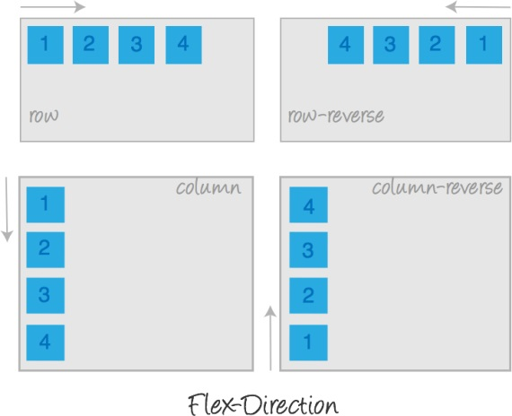
flex-direction Property
flex-direction: defines the direction items are placed in the container, and accepts the following values:
row: Items are placed the same as the text direction.
row-reverse: Items are placed opposite to the text direction.
column: Items are placed top to bottom.
column-reverse: Items are placed bottom to top.

Slide 10
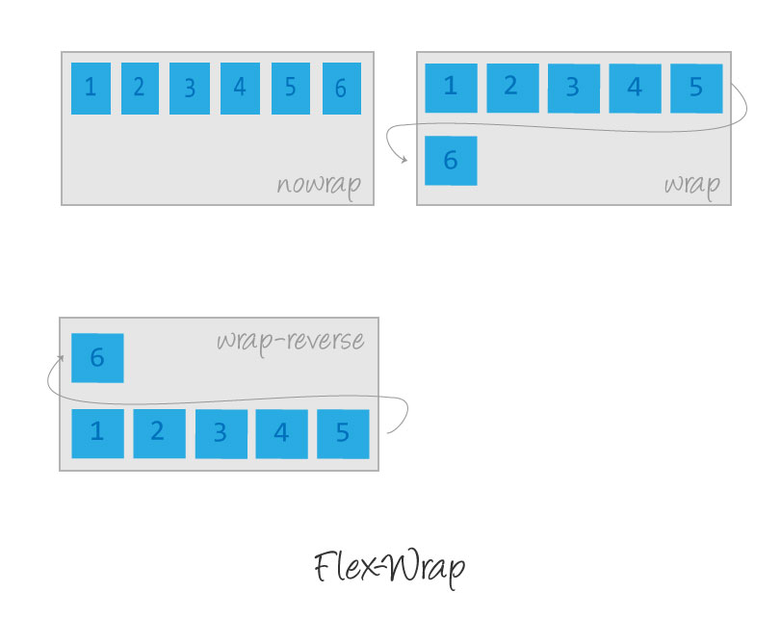
flex-wrap Property
flex-wrap: nowrap | wrap | wrap-reverserow:
Items are placed the same as the text direction.
nowrap: Every item is fit to a single line.
wrap: Items wrap around to additional lines.
wrap-reverse: Items wrap around to additional lines in reverse.

Slide 11
flex-flow Property
The two properties flex-direction and flex-wrap are used so often together that the shorthand property flex-flow was created to combine them. This shorthand property accepts the value of one of the two properties separated by a space.
For example, you can use flex-flow: row wrap to set rows and wrap them.
div { display: flex; flex-flow: row-reverse wrap; }

Slide 12
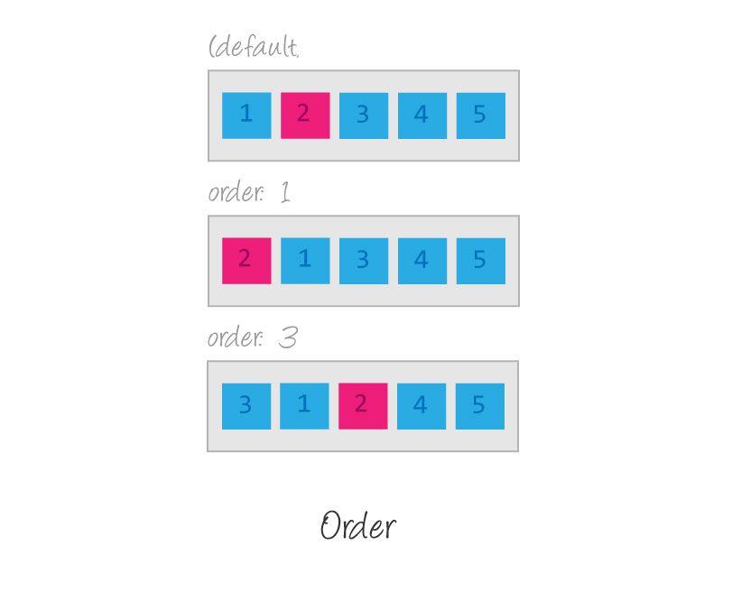
Order
Sometimes reversing the row or column order of a container is not enough. In these cases, we can apply the order property to individual items. By default, items have a value of 0, but we can use this property to set it to a positive or negative integer value.
Order <integer>

Slide 13
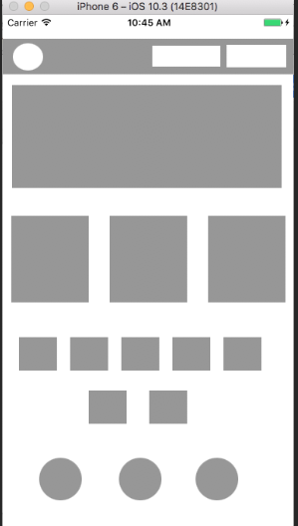
Excercise

